Slide 1
Big Mountain Resort
Operational Improvements & Ticket Pricing
Michael Son

Slide 2
Problem
Task: Increase the revenue by at least $1,540,000 for next season
Strategy
Operational improvements
Prudent, data-driven ticket pricing
Key Resource: A metadata containing information of 330 resorts in the US

Slide 3
Recommendation & Key Findings
Key Findings
Dominant features: fast quads, runs, snowmaking area, vertical drop
Impact of run closures
Recommendation
Extend the vertical drop by 150 ft. with additional run and chair lift
No extra snowmaking coverage necessary
Raise the ticket price by $1.99
Confirm whether closing one run affects the support for the ticket price
Account for other operating costs

Slide 4
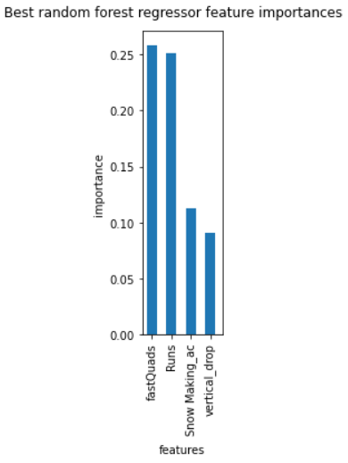
Modeling Results & Analysis
Random Forest Regression Model
Modeled Price: $95.87 ± $10.39
Additional Information
Expected visitors: 350,000
Average # of days visitors ski: 5

Slide 5
Modeling Results & Analysis
Four Model Scenarios
Closing down up to 10 of the least used runs
Extending the vertical drop by 150 ft. with additional run and chair lift without extra snowmaking coverage
Scenario 2 + 2 acres of snowmaking
Extending longest run by 0.2 miles with additional 4 acres of snowmaking capability

Slide 6
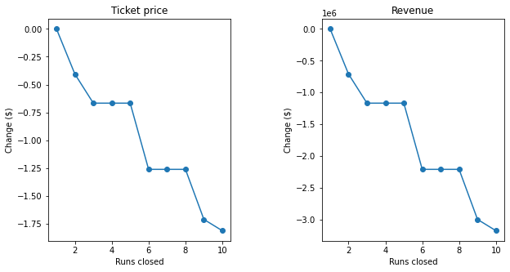
Scenario 1: Impact of Closure of Runs up to 10

Slide 7
Scenario 2, 3, and 4
Scenario 2
Increases support for the ticket price by $1.99 → $3,474,638 over the season
Scenario 3
Same as Scenario 2; a small increase in snowmaking area proved insignificant
Scenario 4
No difference observed; result consistent with the negligibility of ‘longest run’

Slide 8
Conclusion
Recommended ticket price of $82.99 with a room for further raise
Prospective Improvement
Accounting for operating costs and maintenance costs of resort facilities
Reassessment of Scenario 1 with additional information on operating costs
Accounting for expenditure of rental equipment: ski, snowboard, etc.

